Slide 1
Accountability and Control
October 20th, 2022
Wenchen Wang

Slide 2
Last Week
Long-term Financing
Equity Financing
Long-term Debt
Leases
Short-term Management
Working Capital Management
Short-term Resources
Short-term Obligations

Slide 3
Learning Objective
Management Control Systems
Measures of Performance
Quality Control Approaches
Variance Analysis

Slide 4
Management Control Systems (MCS)
Sets of policies and procedures designed to keep operations going according to plan—detect variations and allow for corrective action. - Focus on responsibility accounting.
Combine monitoring, motivation, and incentives.
Require that performance be measured.

Slide 5
Balanced Scorecard
Financial measures are just one part of a larger set of measures that are needed to assess organizational performance and control its operations.
Balanced Scorecard Elements--develop key performance indicators (KPIs) for the
* financial perspective
* customer perspective
* internal business perspective, and
* learning and growth perspective.

Slide 6
Triple Bottom Line Performance
Organizations have many stakeholders and those stakeholders should all be represented in the performance process.
Organizations should be concerned about and measure
financial performance beyond the organization
environmental performance--the impact of its actions throughout the life cycle of its products and services, and
social performance--consider the interdependencies between the organization and individuals and society as a whole.

Slide 7
Quality Control
Cost of Quality Report
Prevention costs
Appraisal costs
Internal failure costs, and
External failure costs.
Total Quality Management (TQM)
Do things right up front
Six Sigma
Reduce the number of failures/defects to fewer than 3.4 defects per million

Slide 8
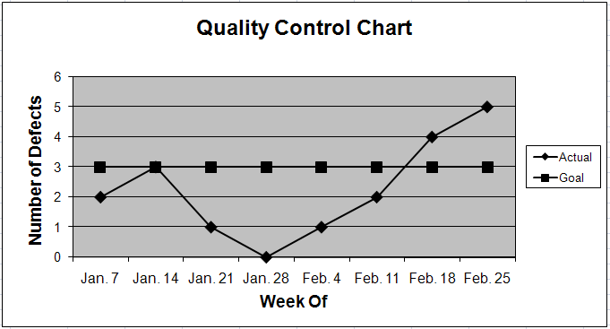
Quality Control Charts

Slide 9
Variance Analysis
Variance analysis investigates differences (variances)
between planned and actual results. It helps managers:
- prepare budgets for the coming year,
- control results in the current year, and
- evaluate the performance of operating units.
Variance analysis focuses on material differences to help managers correct problems and capitalize on opportunities.

Slide 10
Variance Terms
Variance analyses can be prepared for costs, revenues,
and profits/(losses).
Lower than expected costs or higher than expected revenues or profits result in favorable variances.
Favorable variances are designated with a capital “F.”
Higher than expected costs or lower than expected revenues or profits result in unfavorable variances.
Unfavorable variances are designated with a capital “U.”
Some organizations treat favorable variances as positive numbers, and some treat them as negative numbers. The same is true for unfavorable variances.

Slide 11
Variance Mechanics
The budgeted and actual costs and the resulting month and Y-T-D variances in the example below illustrate an unfavorable cost variance.
This Month
Actual | Budget | Variance
$9,200,000 | $8,800,000 | $400,000 U
This Year
Actual | Budget | Variance
$25,476,000 | $25,150,000 | $326,000 U

Slide 12
Department and Line-Item Variance
Variances at most levels of an organization represent aggregations of variances from other levels. For example: total organizational expense variances represent the sum of departmental variances, while departmental variances are made up of line-item variances.
Radiology Department | Actual | Budget | Variance
Salary | $400,000 | $395,000 | $ 5,000 U
Supplies | 400,000 | 205,000 | 195,000 U
Total | $800,000 | $600,000 | $200,000 U

Slide 13
Flexible Budget Variance Analysis
Flexible Variance Analysis allows managers to identify what portion of a total variance is due to:
- differences between the budgeted and actual volume of
some output (Volume Variance)
- differences between the budgeted and actual price (or rate)
of each unit of input or output (Price or Rate Variance), and
differences between the budgeted and actual quantities of the resources used per unit of output (Quantity or Use Variance).

Slide 14
Volume, Price and Quantity Example
 | School Cost Example Total Cost of Textbooks | Hospital Revenue Example Total Oncology Patient Revenue
Volume | Number of third grade students | Number of oncology patients
Quantity | Number of textbooks per third grade student | Days of stay per oncology patient
Price | Cost per textbook for third grade students | Price per day of stay per oncology patient

Slide 15
Variance Computations
Volume Variance:
Original Budget: Budgeted Volume × Budgeted Quantity × Budgeted Rate
Flex Budget: Actual Volume × Budgeted Quantity × Budgeted Rate
Quantity or Use Variance:
Flex Budget: Actual Volume × Budgeted Quantity × Budgeted Rate
- VQA Budget: Actual Volume × Actual Quantity × Budgeted Rate
Price or Rate Variance:
VQA Budget: Actual Volume × Actual Quantity × Budgeted Rate
- Actual: Actual Volume × Actual Quantity × Actual Rate
Total Variance: Volume + Quantity + Price Variances

Slide 16
Volume, Price and Quantity Example
 | School Cost Example Total Cost of Textbooks | Hospital Revenue Example Total Oncology Patient Revenue
Volume | Number of third grade students | Number of oncology patients
Quantity | Number of textbooks per third grade student | Days of stay per oncology patient
Price | Cost per textbook for third grade students | Price per day of stay per oncology patient

Slide 17
Variance Analysis Example
The school district had expected to have 320 students enrolled, but the actual enrollment was 360 students. the school district had expected to use an average of four books per student at a cost of $25 each, it actually acquired five books per student, with an average cost of $21 each. Calculate the total variance.

Slide 18
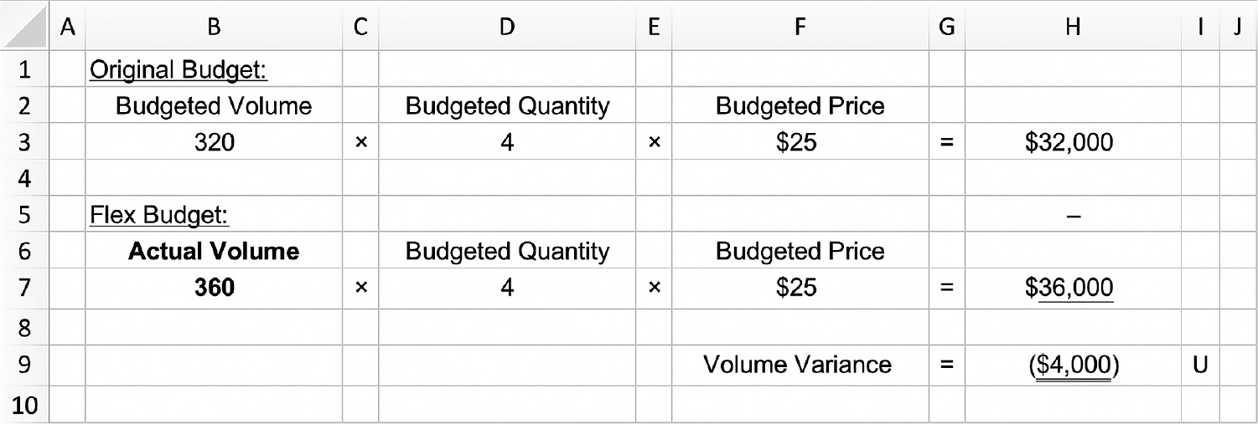
Variance Analysis Example

Slide 19
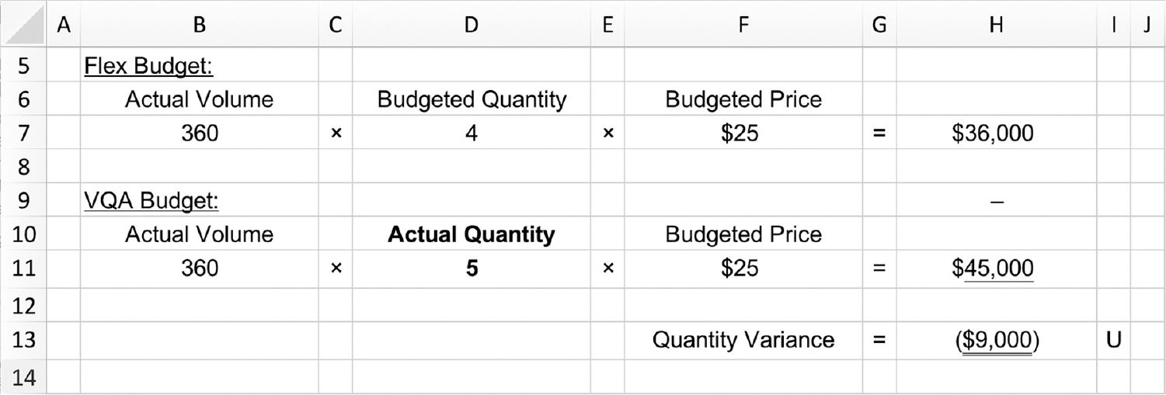
Variance Analysis Example

Slide 20
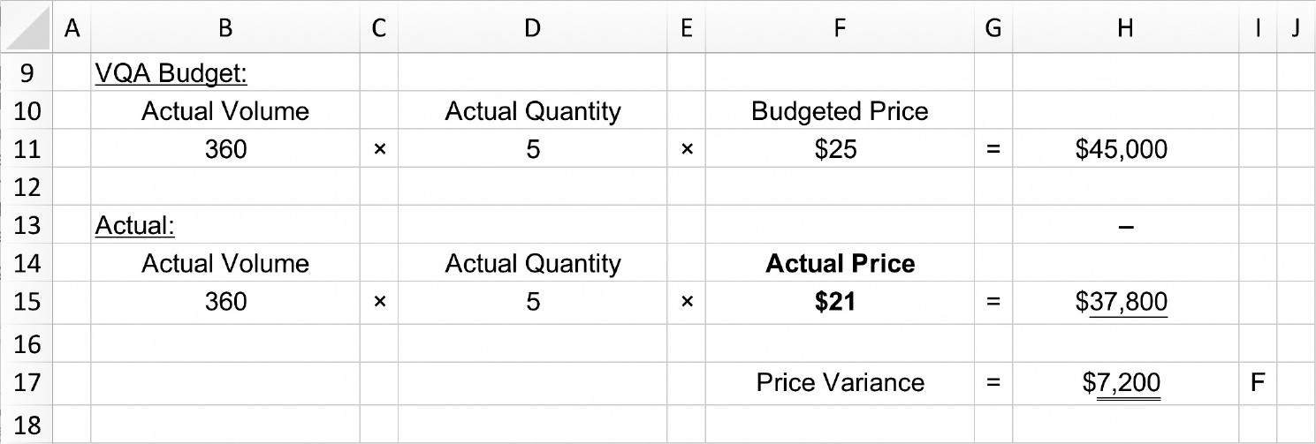
Variance Example

Slide 21
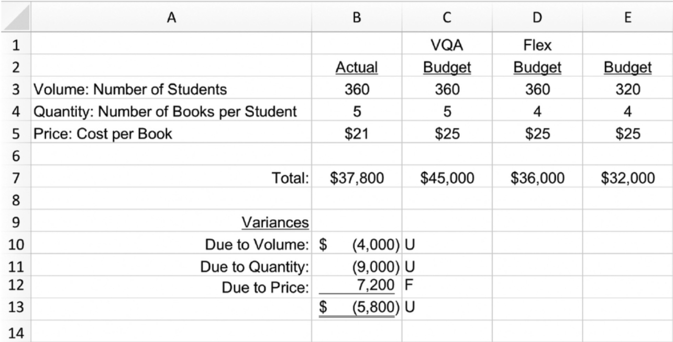
VQA Budget

